Slide 1


Football Website
Name: Mean Diamand
Neptun Code: KSG25Z
Supervisor: Mohammad Saleem

Slide 2


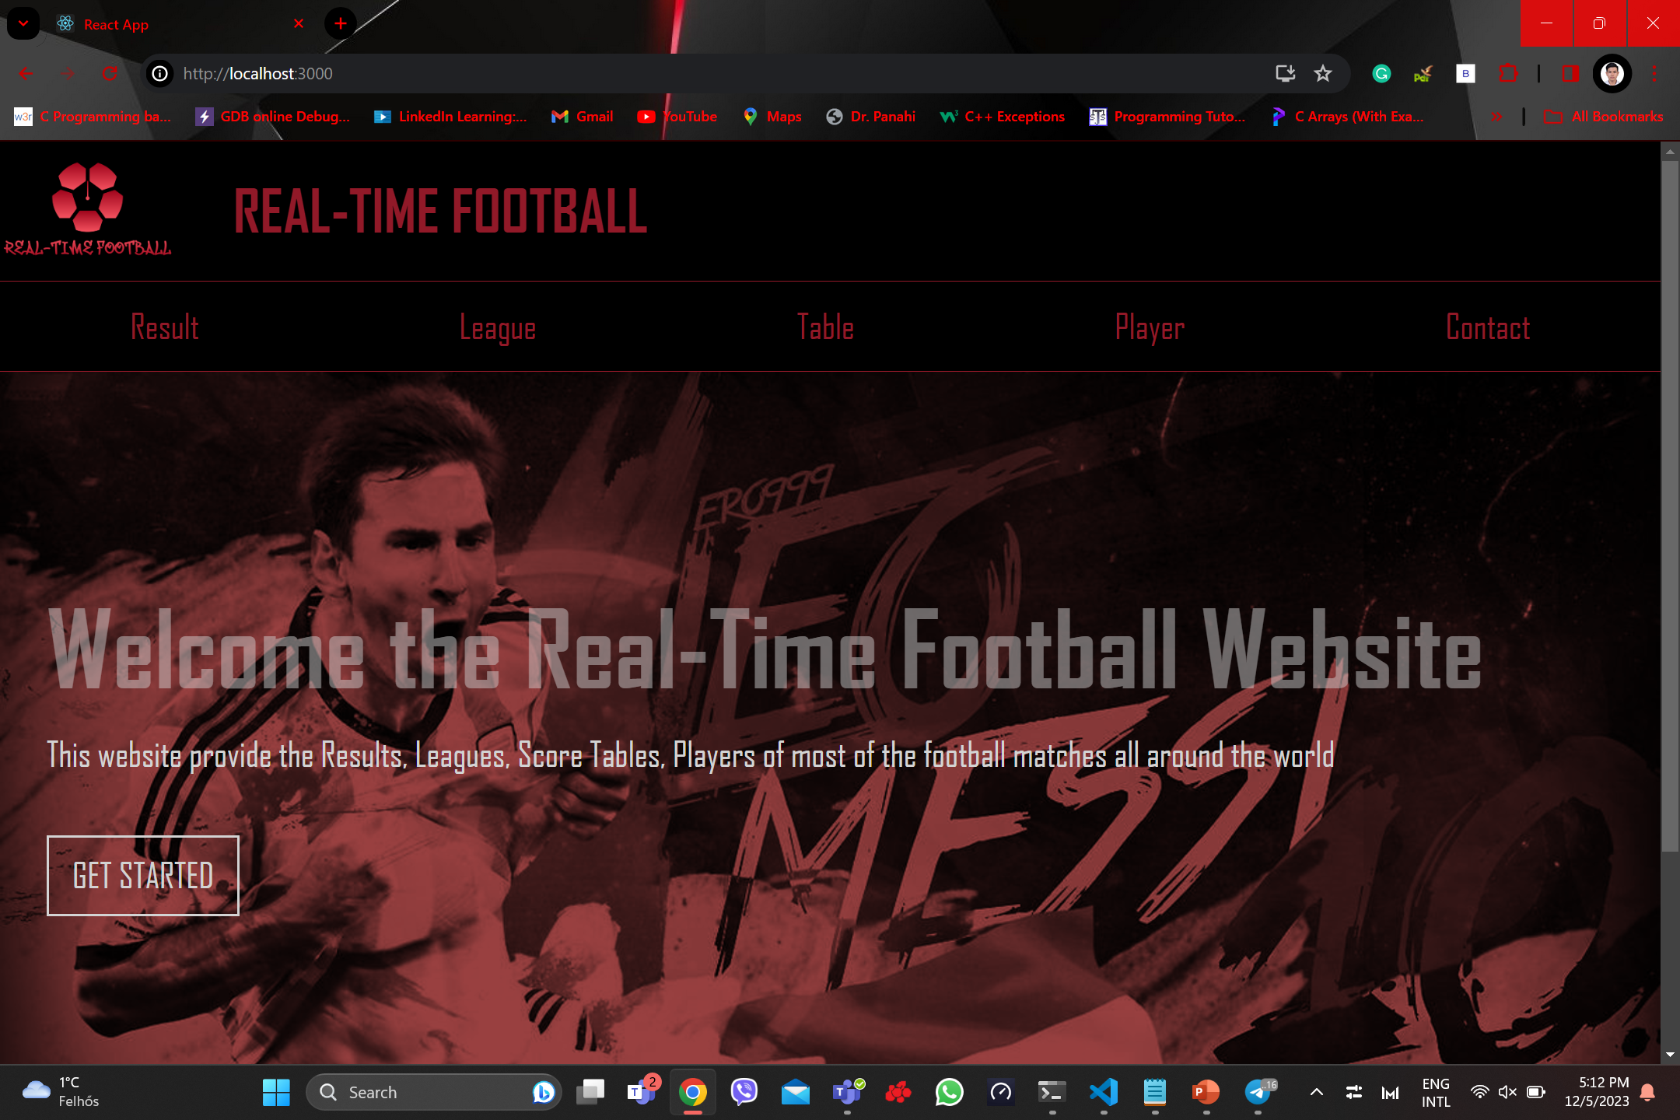
Real-Time Football

Slide 4
Technologies Used
ReactJS
BootStrap
RapidAPI
CSS

Slide 5

ReactJS
Open-source JavaScript library
React Router library for navigation and routing
JSX(JavaScript XML)

Slide 6
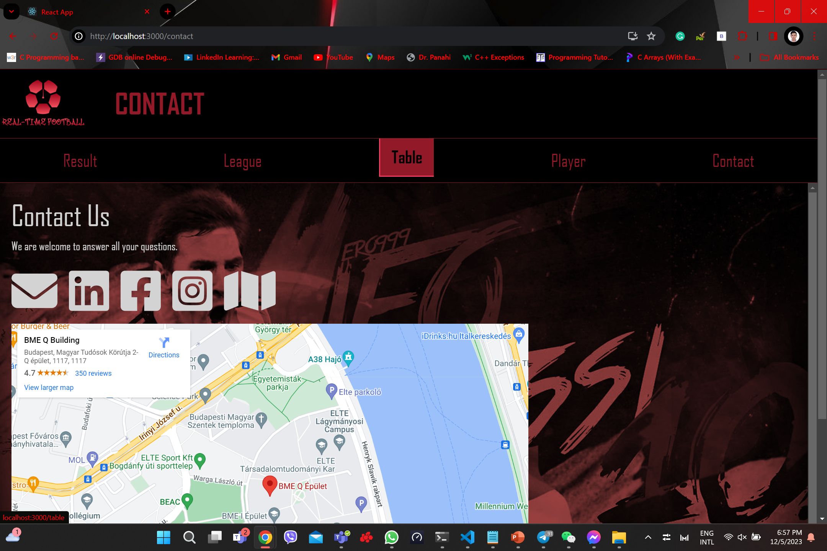
CSS(Cascading Style Sheet
Style Sheet Language
Properties
Responsive Design

Slide 8
BootStrap
Open-source front-end framework
CSS Components

Slide 10

RapidAPI
API Marketplace
API Management

Slide 11

Methodologies and Design
Inspired by the Livescore football website
Connect with Football events
Provide great user experience
Data Accuracy

Slide 12

Features and Functionalities
Result
League
Table
player

Slide 13
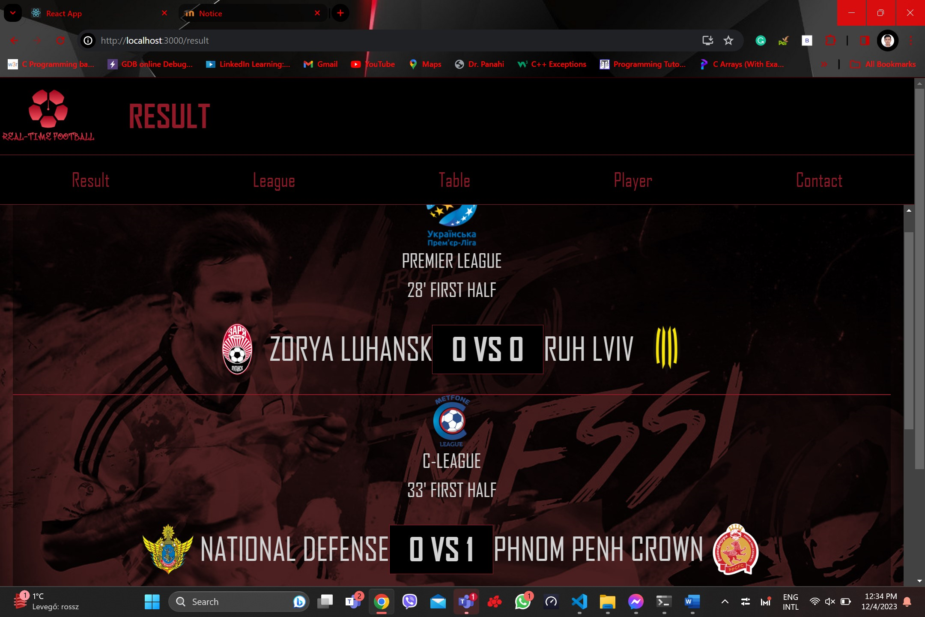

RESULT

Slide 14
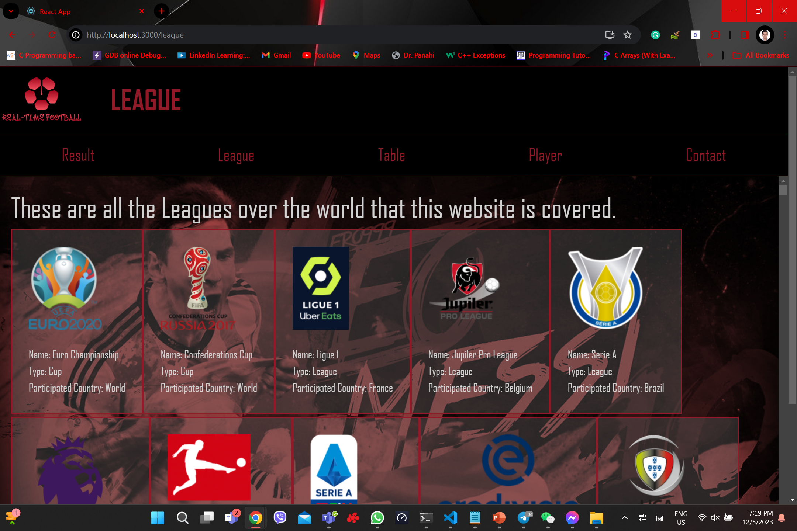

LEAGUE

Slide 15
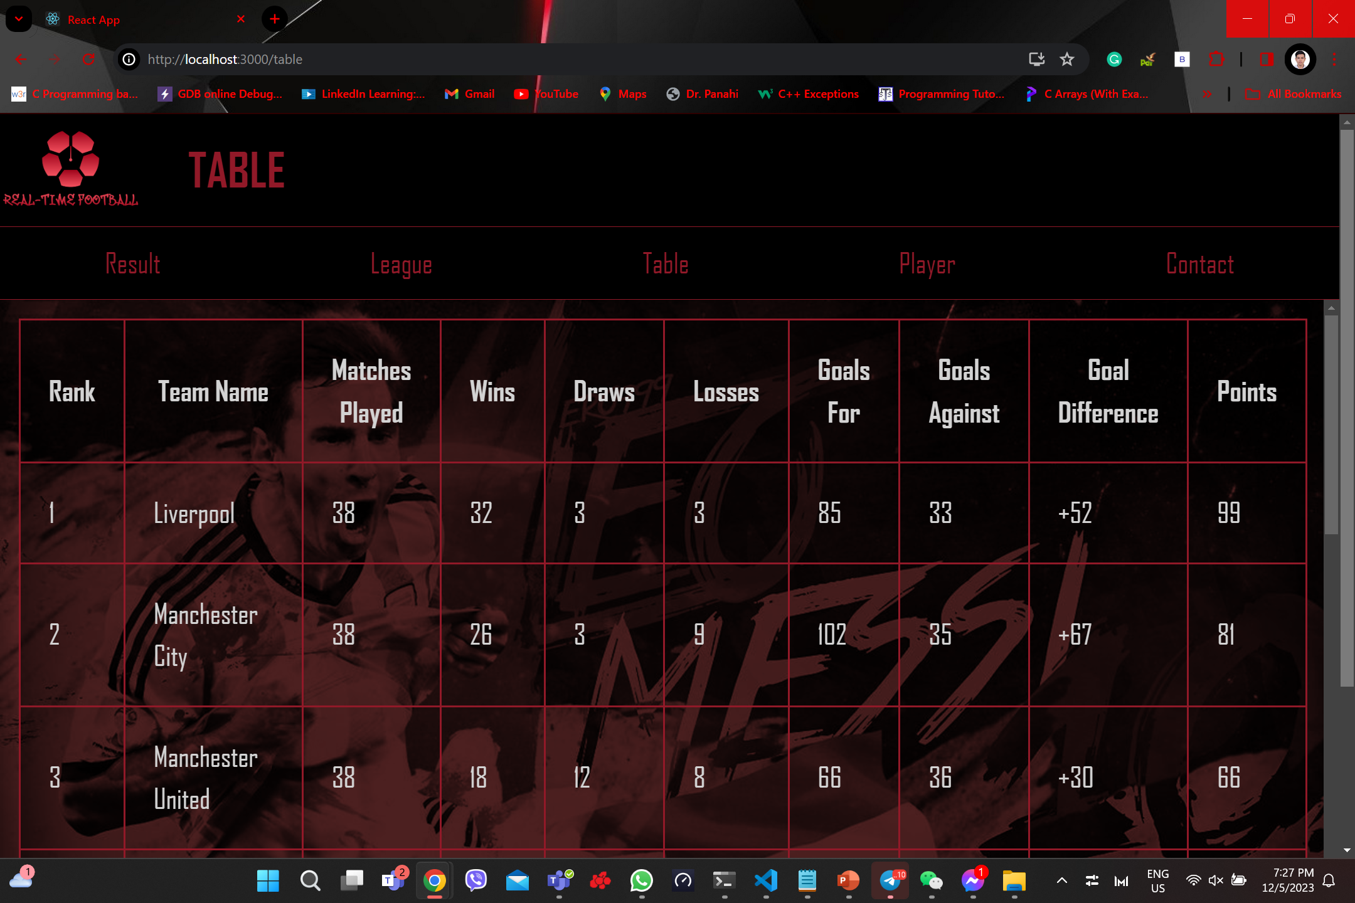

TABLE

Slide 16
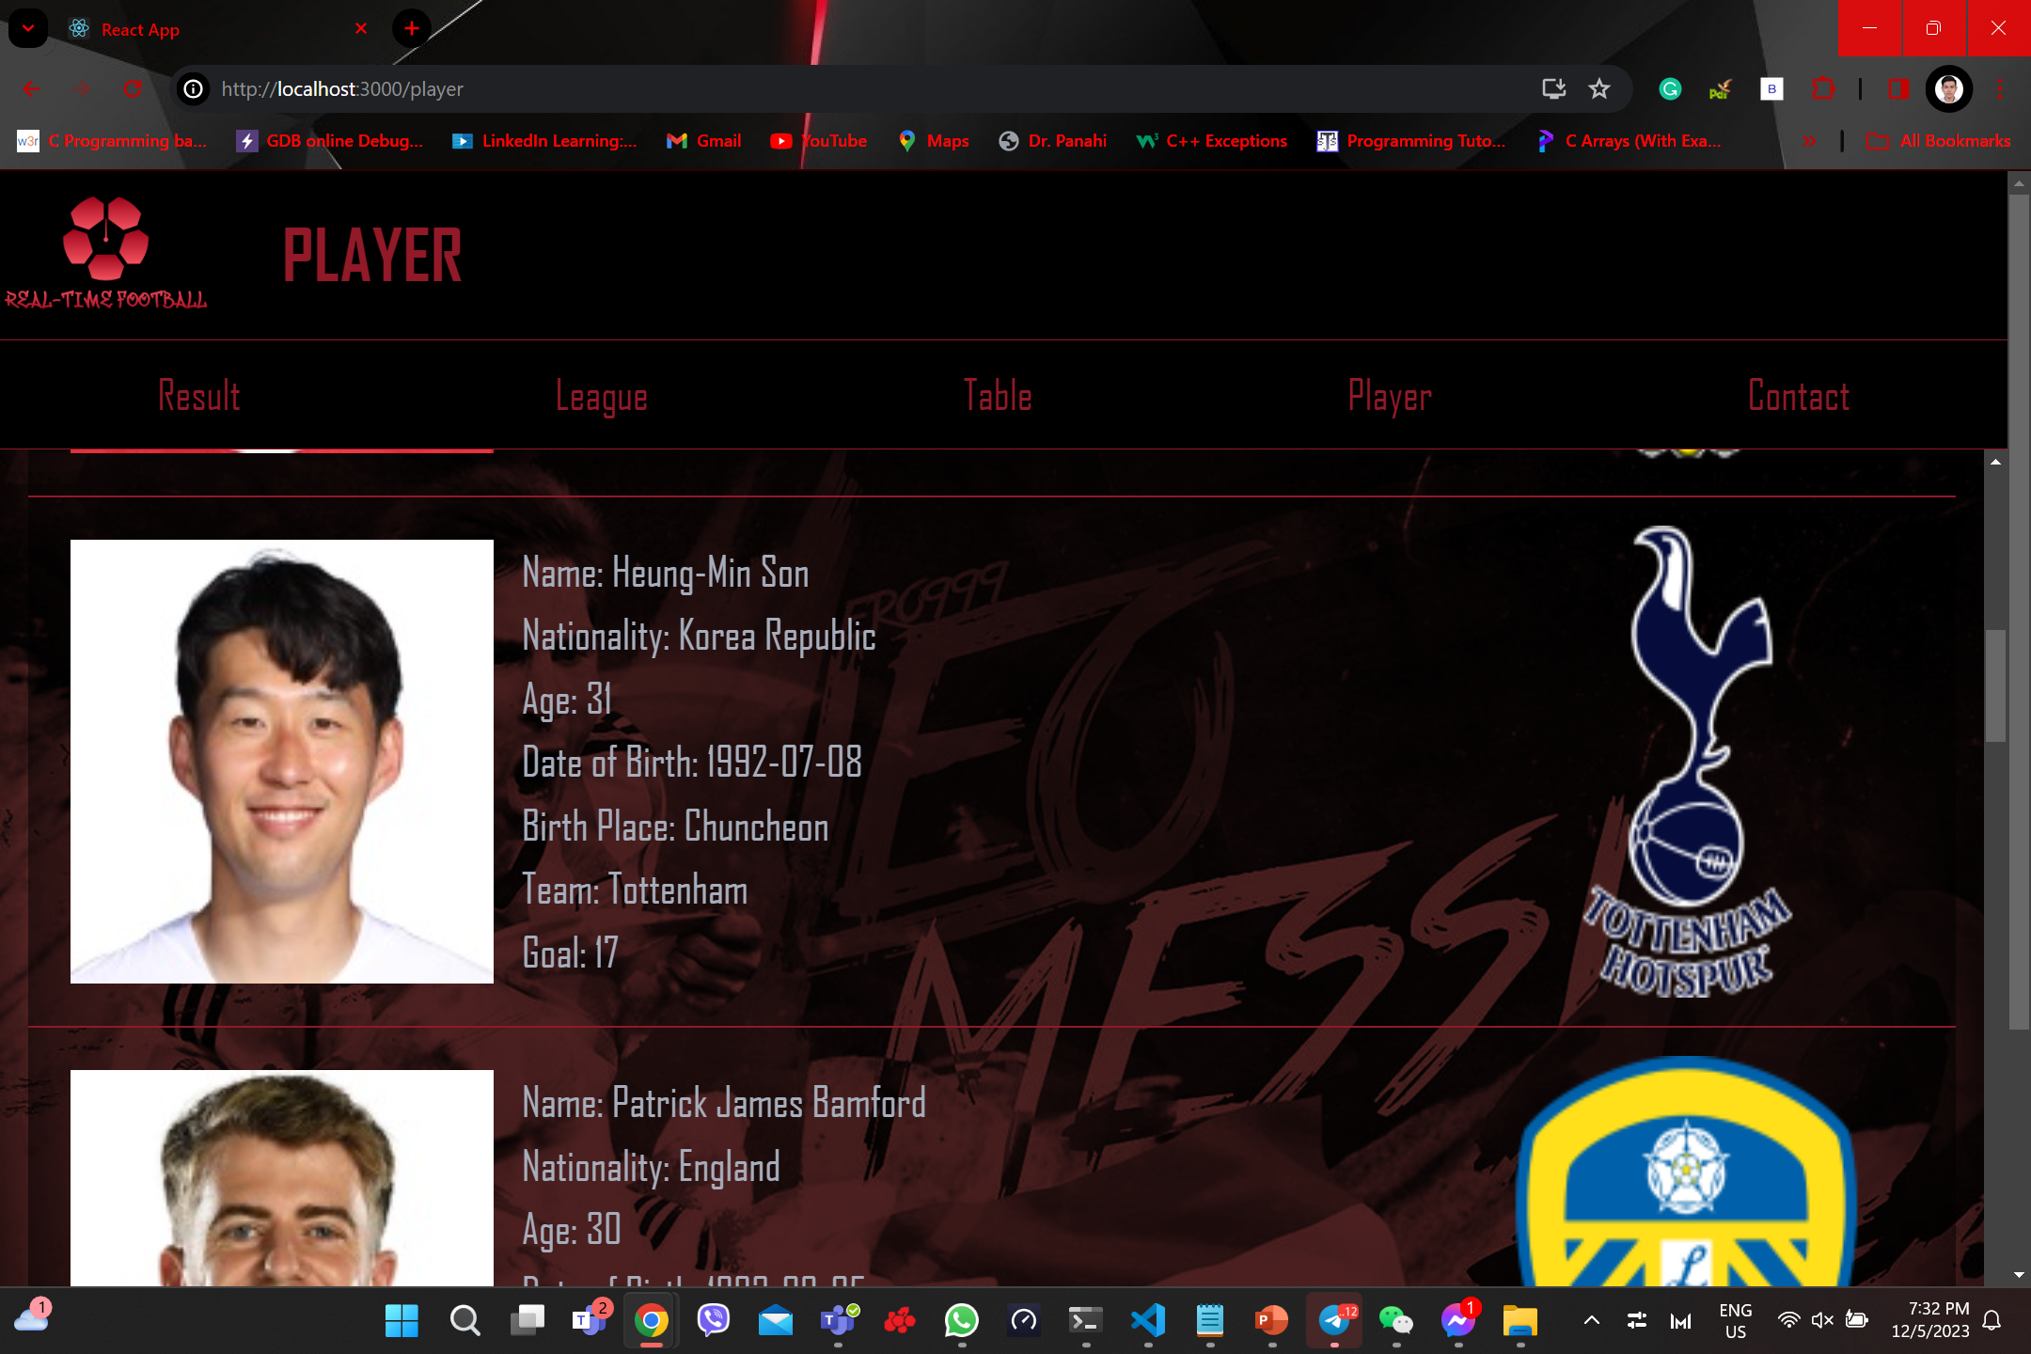

PLAYER

Slide 17
Thank you for your participation
Name: Mean Diamand
Neptun Code: KSG25Z
Supervisor: Mohammad Saleem

